Slide 1
Impact of Covid vaccination
Following the Data

Slide 2
Comparing decline in Birth rate and Live Births

Slide 3
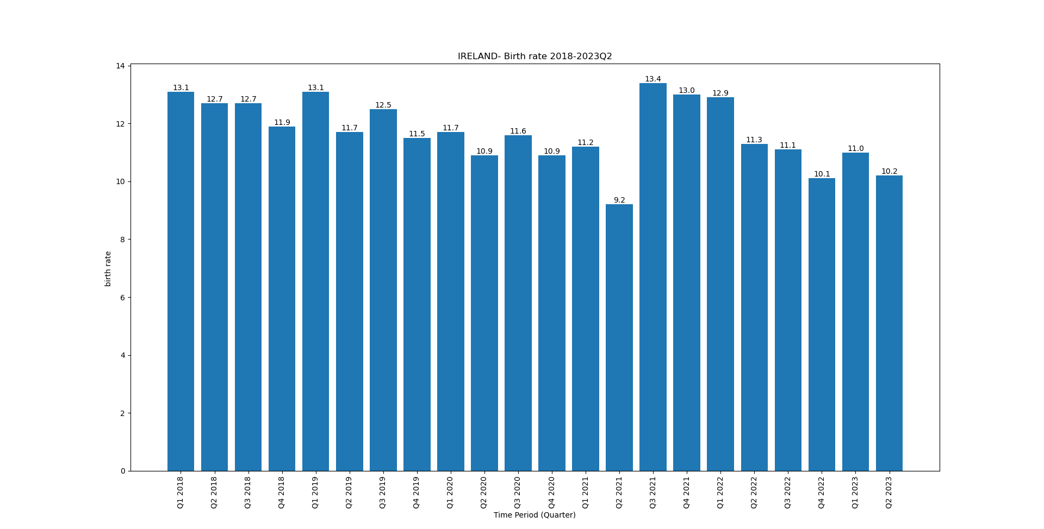
Ireland
Started vaccine rollout from May-2021 for Everyone aged 18-64

Slide 4
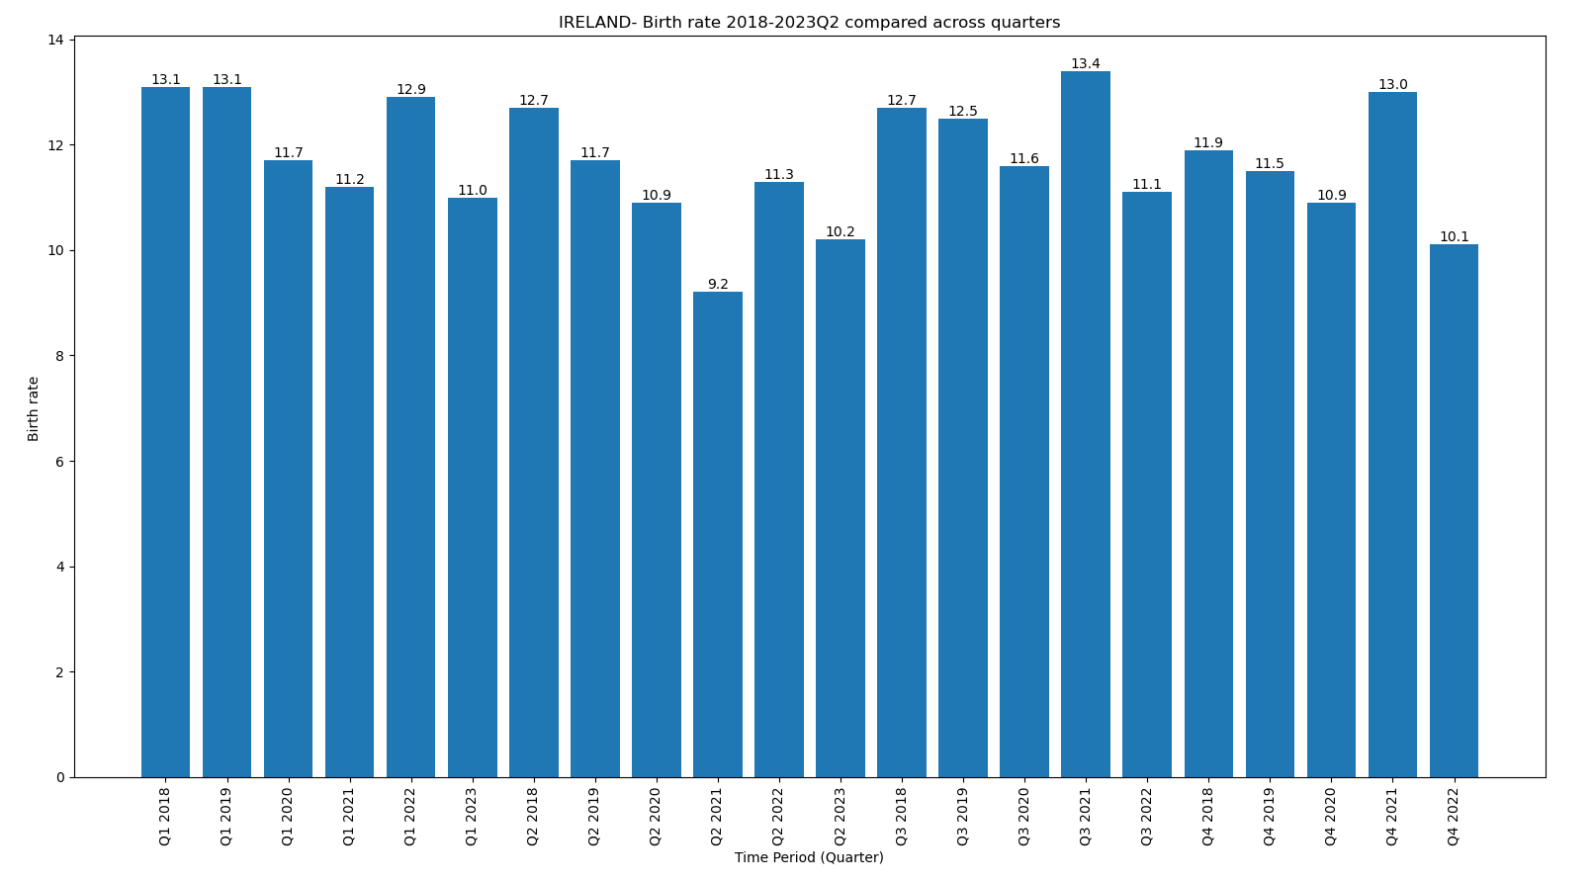
Ireland
Started vaccine rollout from May-2021 for Everyone aged 18-64

Slide 5
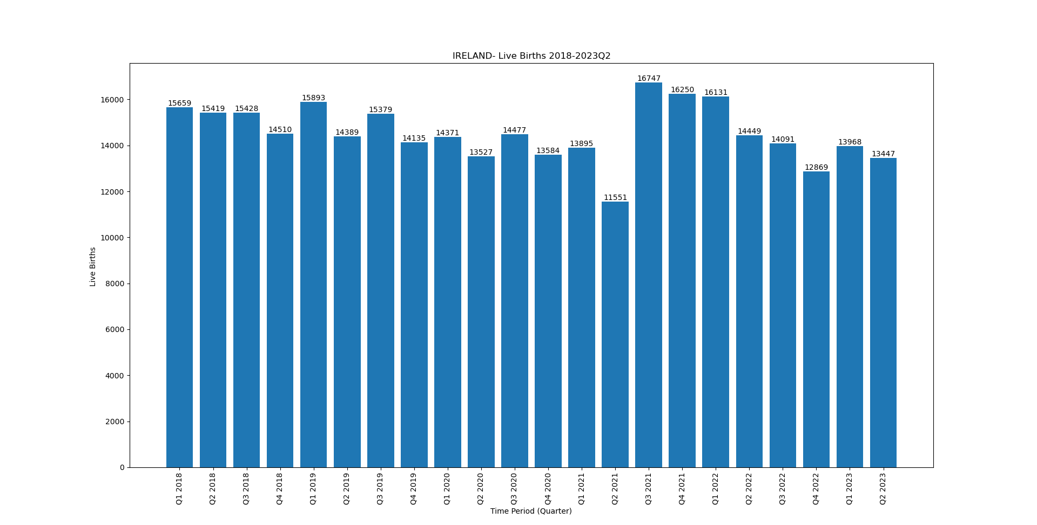
Ireland
Started vaccine rollout from May-2021 for Everyone aged 18-64

Slide 6
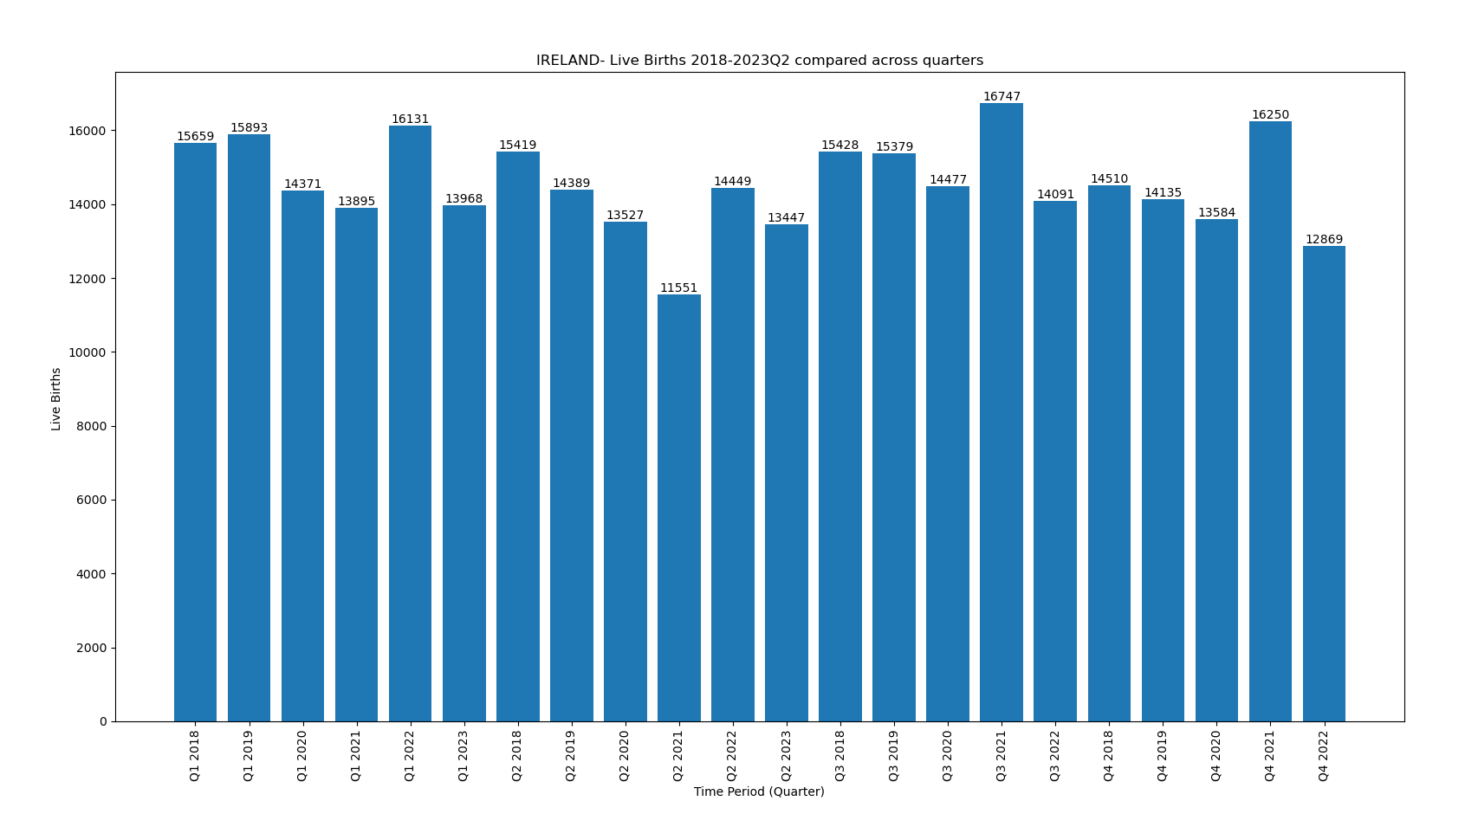
Ireland
Started vaccine rollout from May-2021 for Everyone aged 18-64

Slide 7
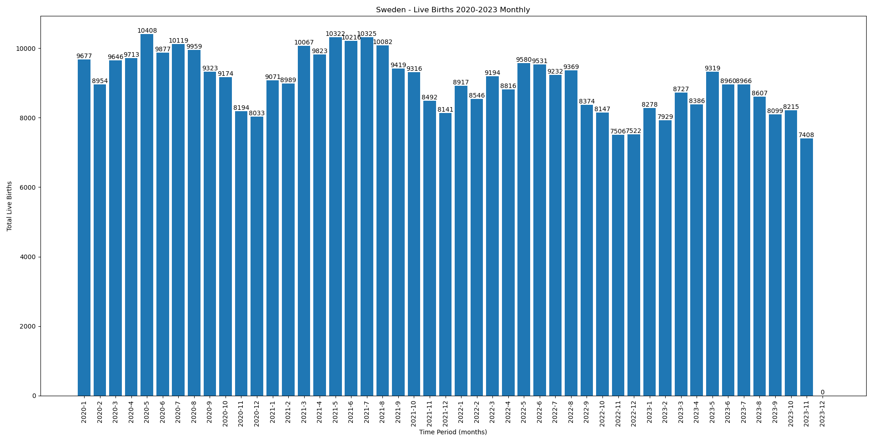
Sweden
Started vaccine rollout from Jun-2021 for Everyone aged 18-64

Slide 8
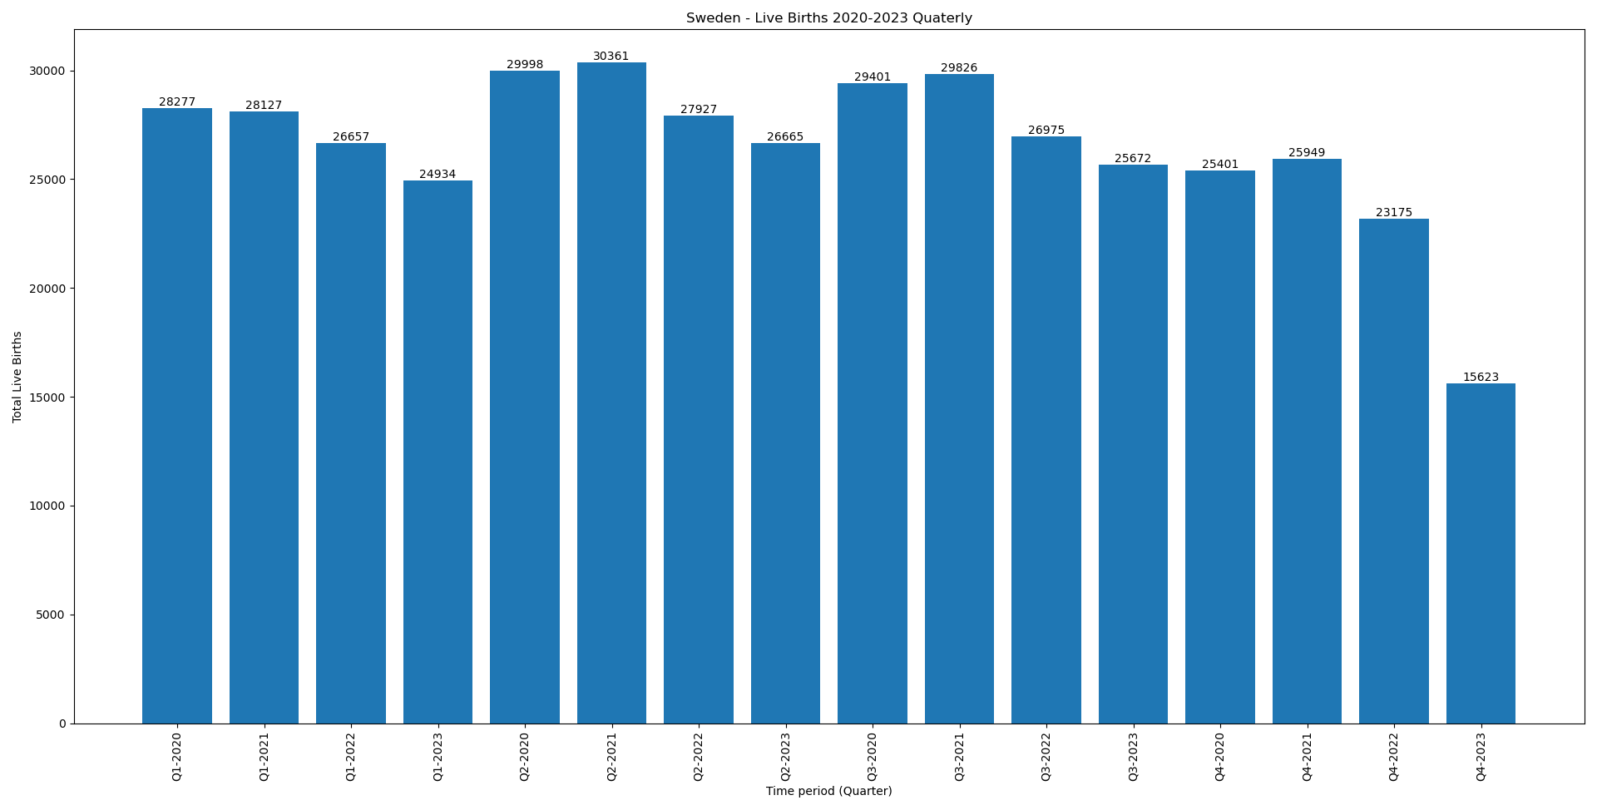
Sweden
Started vaccine rollout from June-2021 for Everyone aged 18-64

Slide 9
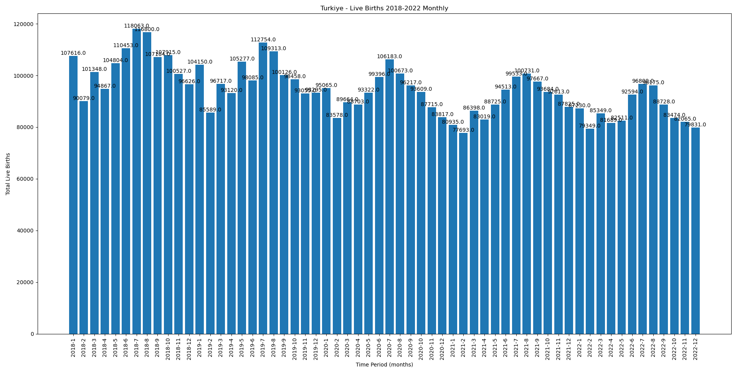
Turkey
Started vaccine rollout from July-2021 for Everyone aged 18-64

Slide 10
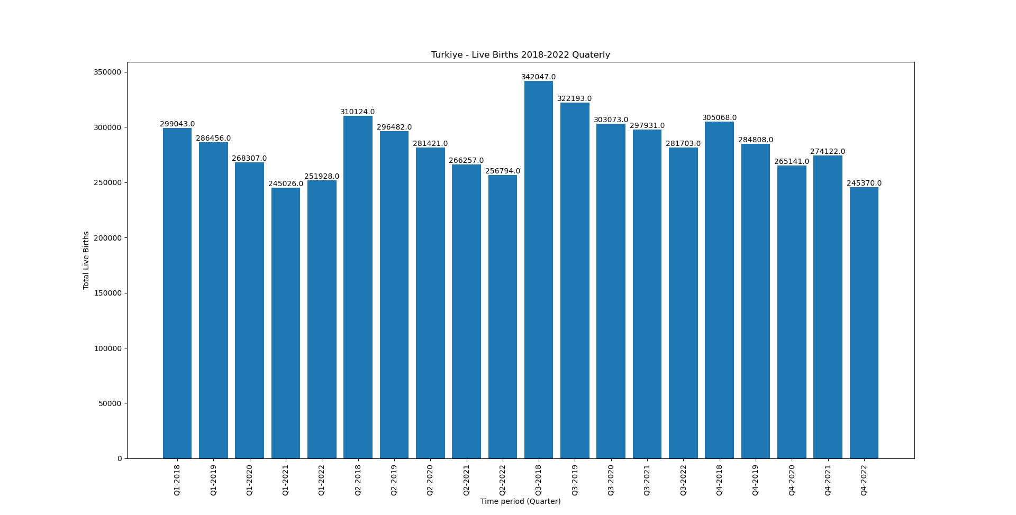
Turkey
Started vaccine rollout from July-2021 for Everyone aged 18-64

Slide 11
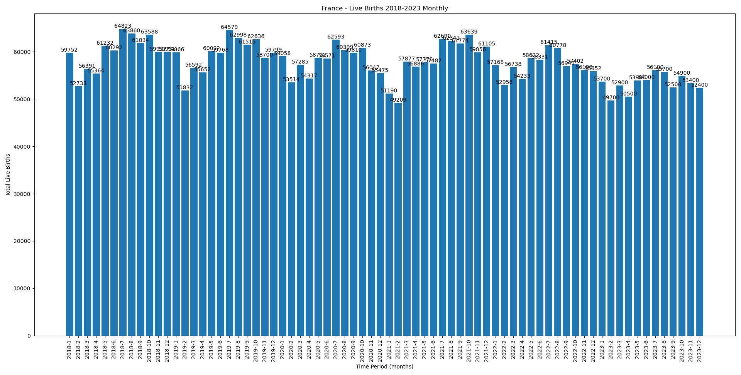
France
Started vaccine rollout from april-2021 for Everyone aged 18-64
A dip can be seen in the months of feb, march and april

Slide 12
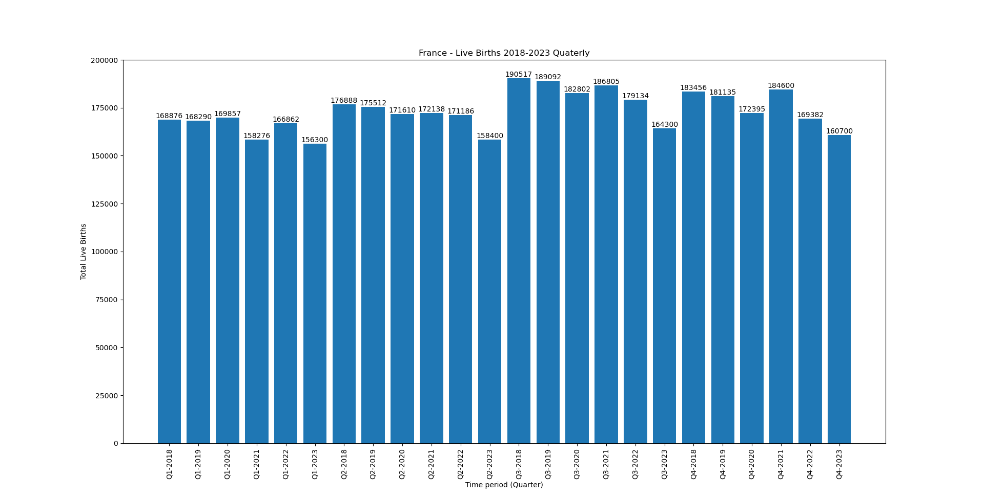
France
Started vaccine rollout from april-2021 for Everyone aged 18-64

Slide 13
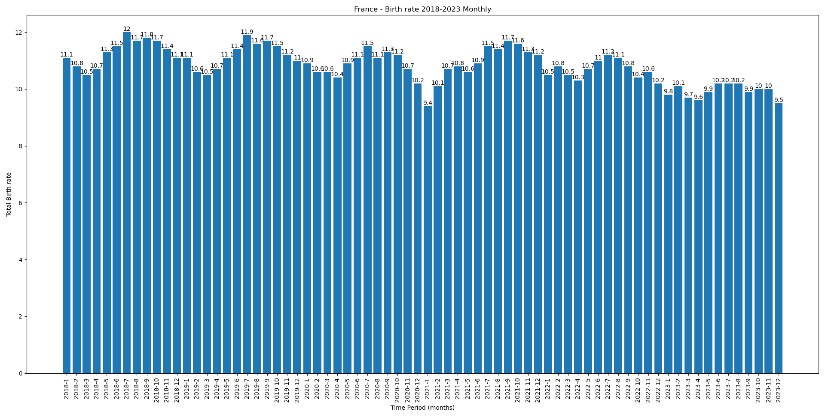
France
Started vaccine rollout from april-2021 for Everyone aged 18-64
A dip can be seen in the months of Jan-Apr 2022 in birth rate

Slide 14
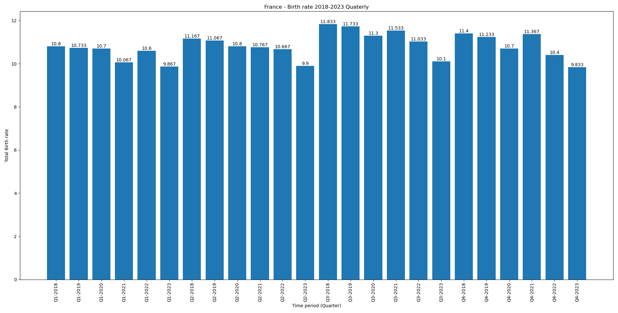
France
Started vaccine rollout from april-2021 for Everyone aged 18-64
A dip can be seen in the months of Jan-Apr 2022 (Q1 2022) in birth rate

Slide 15
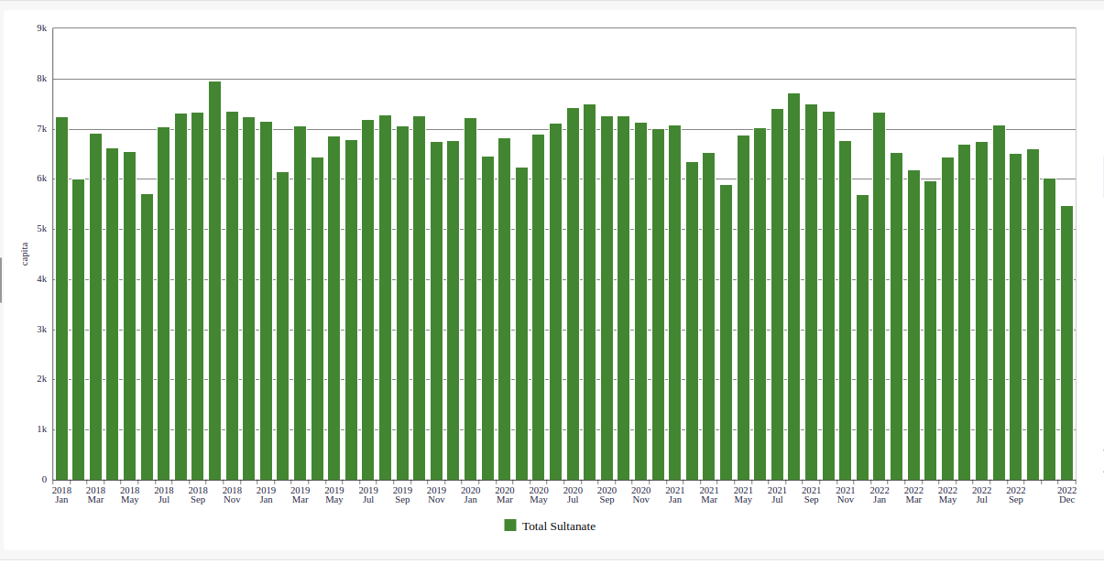
Oman
Started vaccine rollout from ?
A dip can be seen in the months mar-may 2021

Slide 16
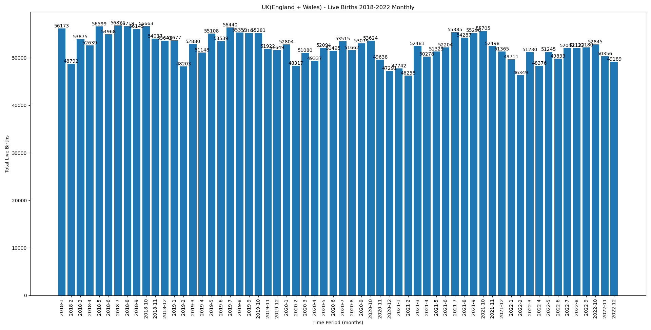
UK (England + wales)
Started vaccine rollout from april-Jun 2021
dip in the months of Jan, feb, april 2022

Slide 17
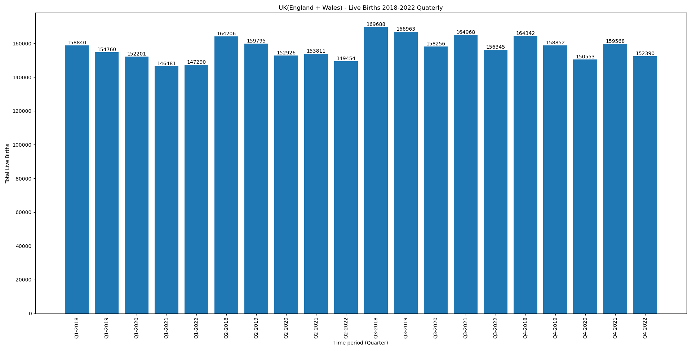
UK (England + wales)
Started vaccine rollout from april-Jun 2021

Slide 18
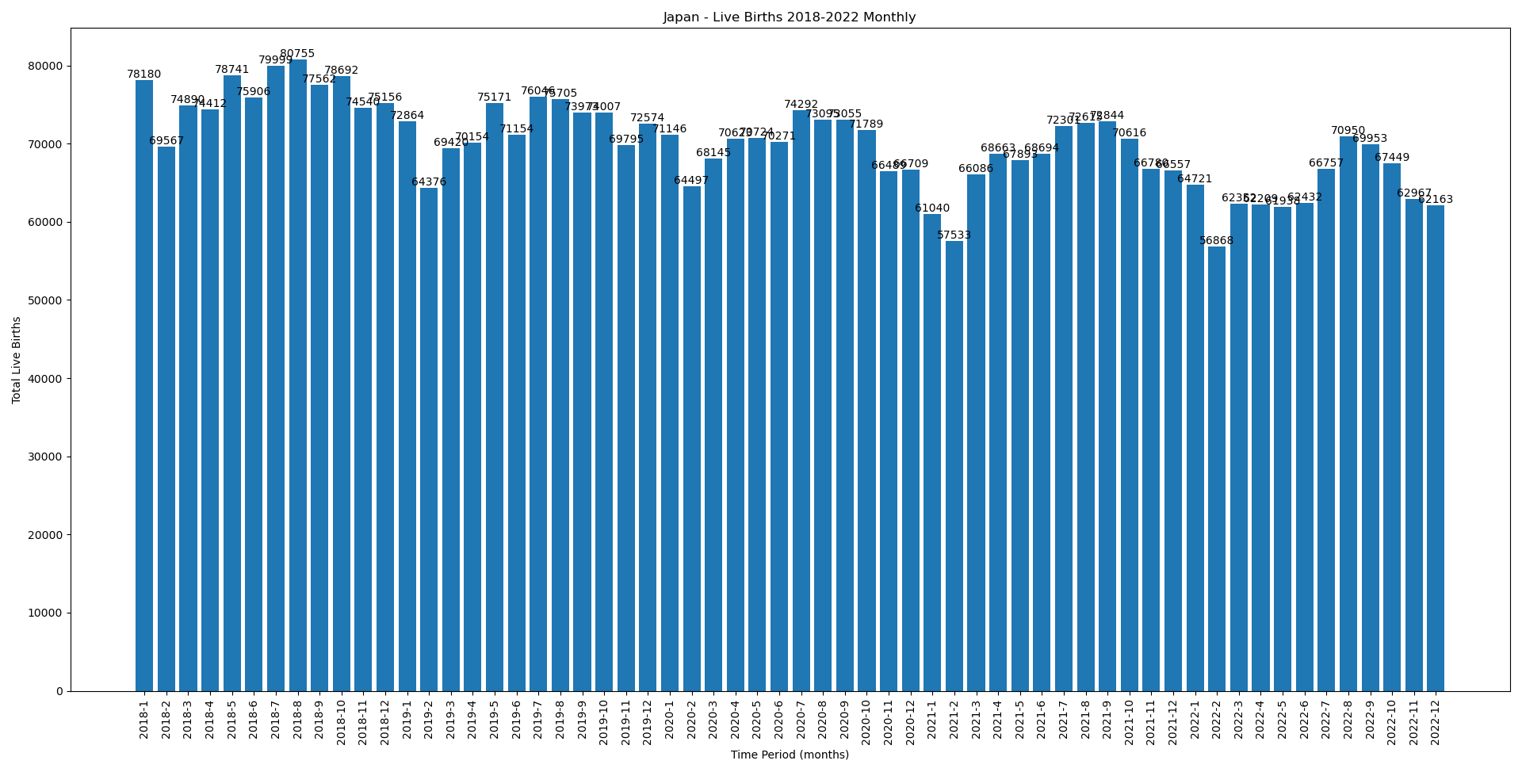
Japan
Started vaccine rollout from ?

Slide 19
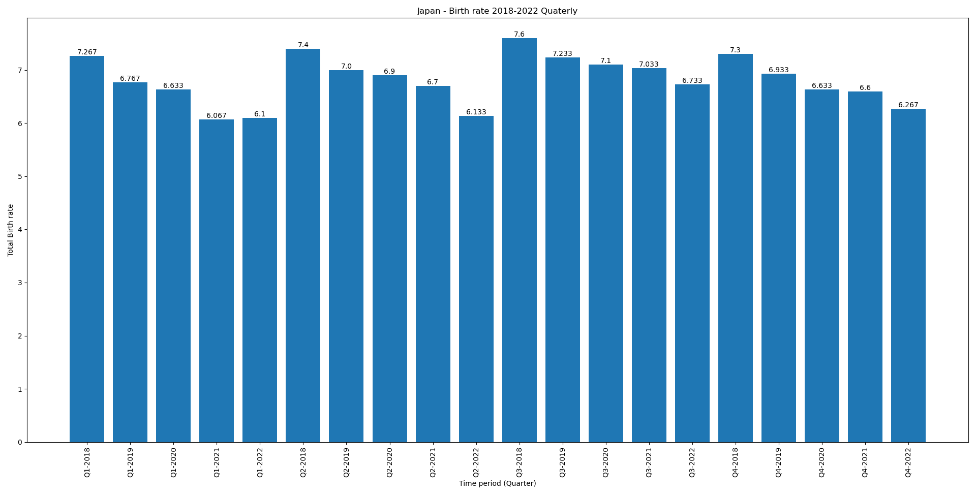
Japan
Started vaccine rollout from ?

Slide 20
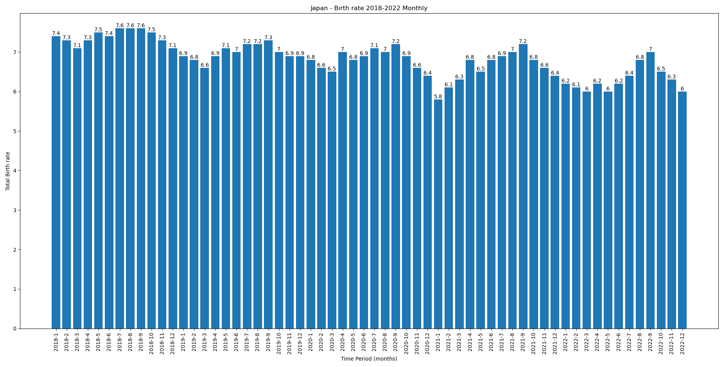
Japan
Started vaccine rollout from ?

Slide 21
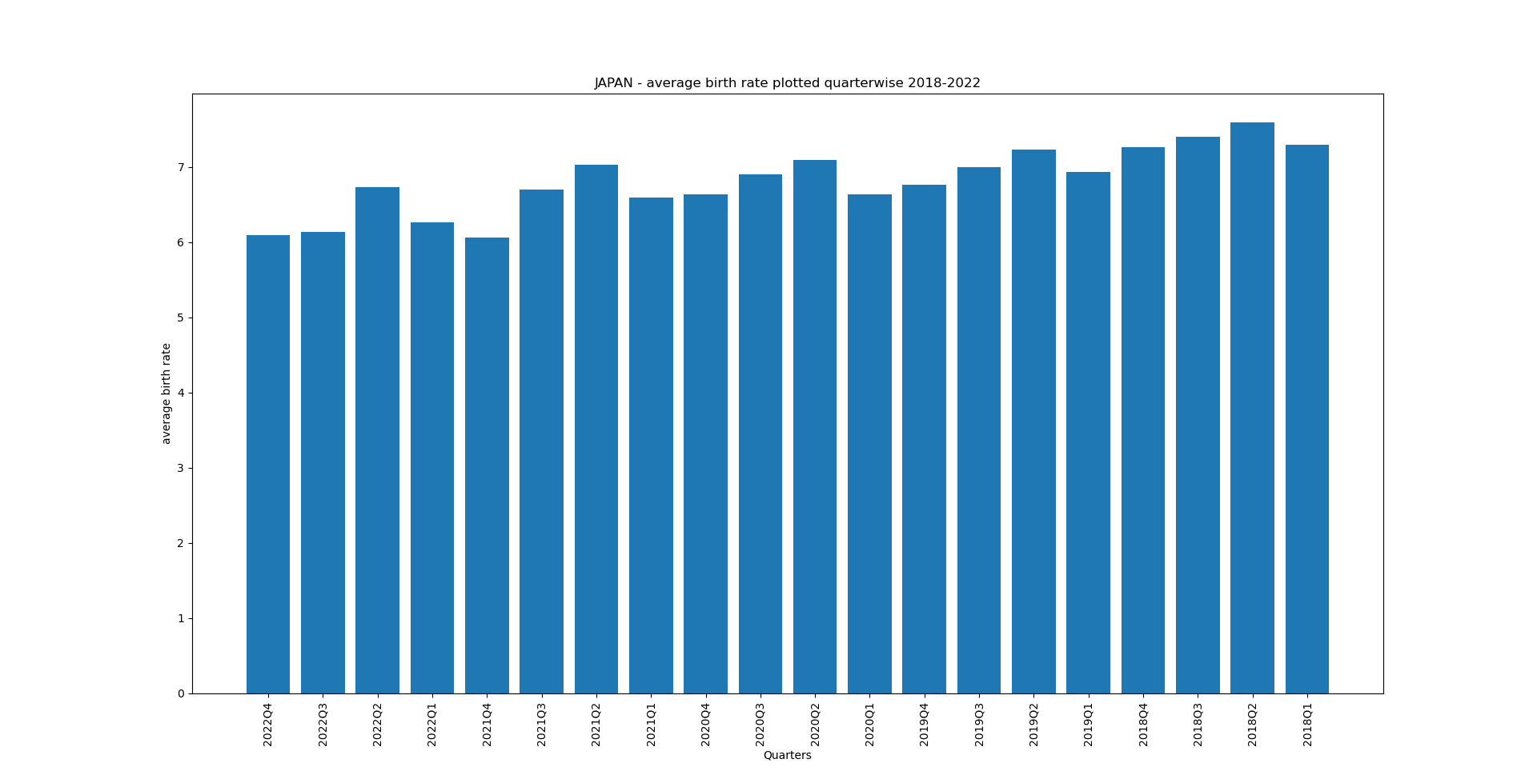
Japan
Started vaccine rollout from ?

Slide 22
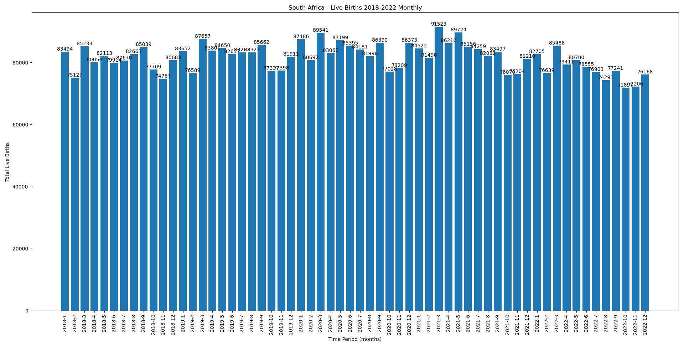
South Africa
Started vaccine rollout from Jul-2021 for 35-49 and Aug-2021 for 18-34

Slide 23
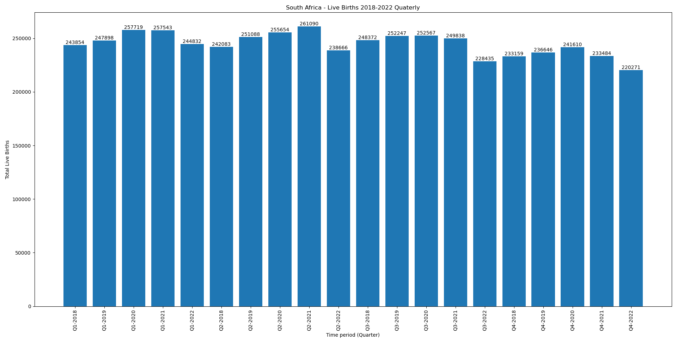
South Africa
Started vaccine rollout from Jul-2021 for 35-49 and Aug-2021 for 18-34
dip in the months apr-may 2022, Q2-2022

Slide 24
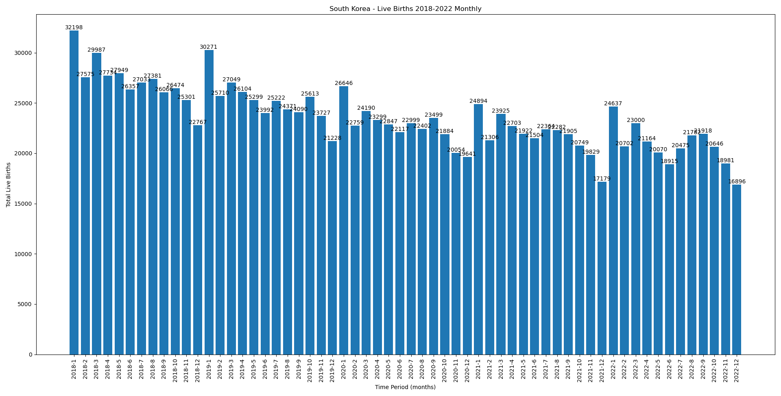
South korea
Started vaccine rollout from feb-2021
Very large dip in the month of Dec-2021

Slide 25
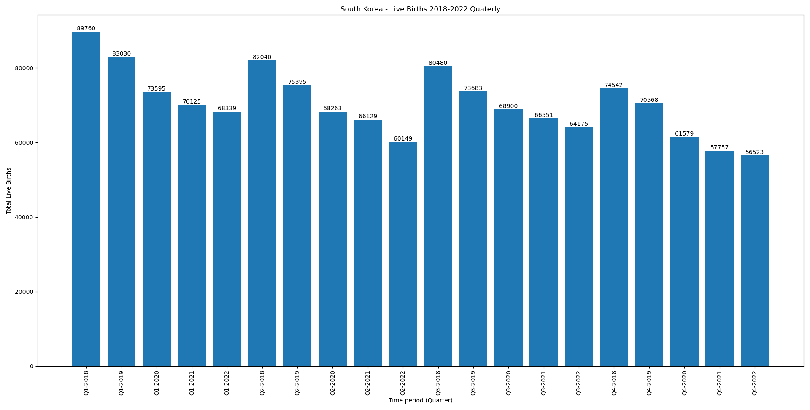
South korea
Started vaccine rollout from Feb-2021

Slide 26
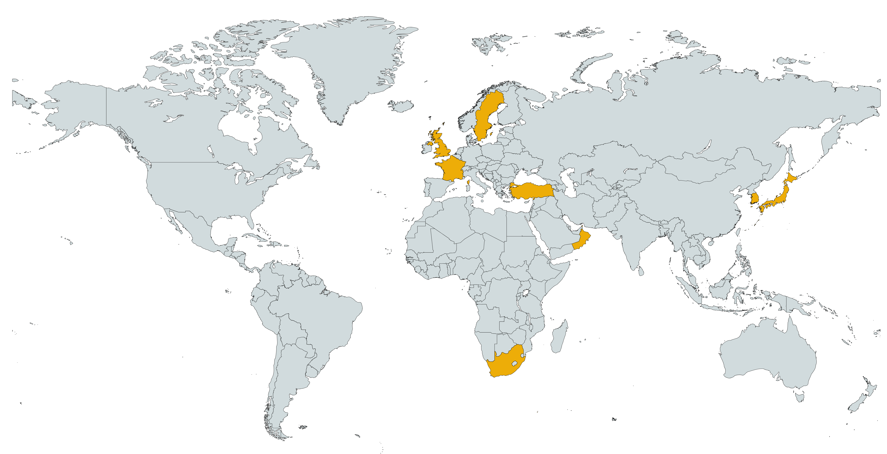
UK : Started vaccination from apr-jun 2021
Sweden : started vaccination from Jun-2021
South Korea: started vaccinations from
Ireland: Started vaccination may-2021
Japan: Started vaccinations
Oman: Started Vaccinations
France : Started Vaccinations apr-2021
Turkiye: started vaccinations ?
South Africa: started Vaccinations jul-Aug 2021

Slide 27
Covid Infographics
Jupiter is a gas giant and the biggest planet in the Solar System
56%
Mercury is the closest planet to the Sun and is the smallest one
12%
It has a beautiful name and is the second one in the Solar System
84%

Slide 28
Covid Infographics
13,14 m
Mercury it’s the closest planet to the Sun
97,55 m
Earth is the third planet from the Sun
10,88 m
Despite being red, is actually a cold place

Slide 29
Instructions for use (free users)
In order to use this template, you must credit Slidesgo by keeping the Thanks slide.
You are allowed to:
Modify this template.
Use it for both personal and commercial purposes.
You are not allowed to:
Sublicense, sell or rent any of Slidesgo Content (or a modified version of Slidesgo Content).
Distribute this Slidesgo Template (or a modified version of this Slidesgo Template) or include it in a database or in any other product or service that offers downloadable images, icons or presentations that may be subject to distribution or resale.
Use any of the elements that are part of this Slidesgo Template in an isolated and separated way from this Template.
Delete the “Thanks” or “Credits” slide.
Register any of the elements that are part of this template as a trademark or logo, or register it as a work in an intellectual property registry or similar.
For more information about editing slides, please read our FAQs or visit Slidesgo School:
https://slidesgo.com/faqs and https://slidesgo.com/slidesgo-school

Slide 30
Instructions for use (premium users)
In order to use this template, you must be a Premium user on Slidesgo.
You are allowed to:
Modify this template.
Use it for both personal and commercial purposes.
Hide or delete the “Thanks” slide and the mention to Slidesgo in the credits.
Share this template in an editable format with people who are not part of your team.
You are not allowed to:
Sublicense, sell or rent this Slidesgo Template (or a modified version of this Slidesgo Template).
Distribute this Slidesgo Template (or a modified version of this Slidesgo Template) or include it in a database or in any other product or service that offers downloadable images, icons or presentations that may be subject to distribution or resale.
Use any of the elements that are part of this Slidesgo Template in an isolated and separated way from this Template.
Register any of the elements that are part of this template as a trademark or logo, or register it as a work in an intellectual property registry or similar.
For more information about editing slides, please read our FAQs or visit Slidesgo School:
https://slidesgo.com/faqs and https://slidesgo.com/slidesgo-school

Slide 31
Infographics
You can add and edit some infographics to your presentation to present your data in a visual way.
Choose your favourite infographic and insert it in your presentation using Ctrl C + Ctrl V or Cmd C + Cmd V in Mac.
Select one of the parts and ungroup it by right-clicking and choosing “Ungroup”.
Change the color by clicking on the paint bucket.
Then resize the element by clicking and dragging one of the square-shaped points of its bounding box (the cursor should look like a double-headed arrow). Remember to hold Shift while dragging to keep the proportions.
Group the elements again by selecting them, right-clicking and choosing “Group”.
Repeat the steps above with the other parts and when you’re done editing, copy the end result and paste it into your presentation.
Remember to choose the “Keep source formatting” option so that it keeps the design. For more info, please visit Slidesgo School.

